Slide 1
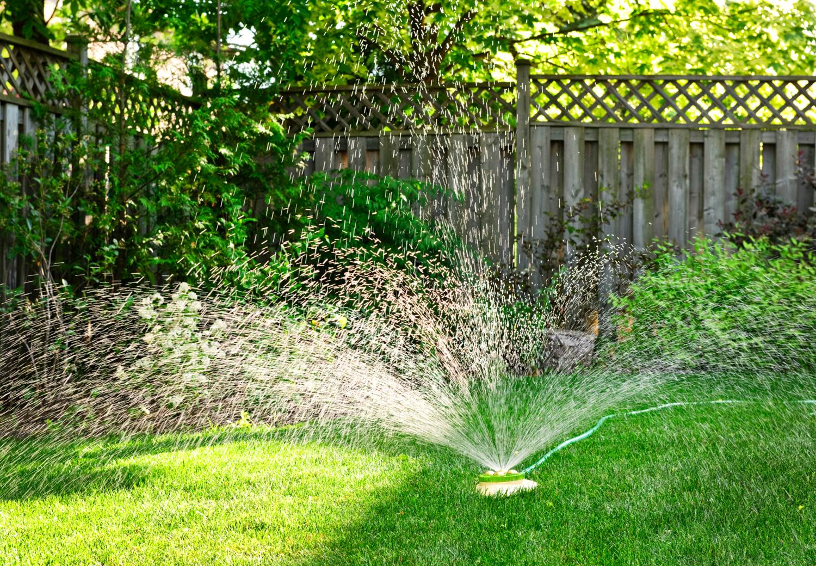
Water
Outdoor
Indoor

Slide 2
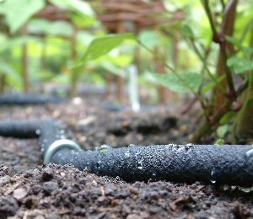
Outdoor Water
Irrigation
Minimize need with ______________
Increase delivery efficiency _____________________
Decrease Frequency
Vehicle Washing
Drain into lawn or garden
Storm Water Control
Green Roof
Infiltration Basin
Rain Garden
Use rainwater
Or grey water
Or waste water
www.brackettfoundation.com
Notes:
Irrigation
Minimize need with Xeriscaping
Increase delivery efficiency (soaker hose, drip irrigation)
Decrease Frequency
Let lawn go dormant during dry spell
Tied to soil moisture (Institutions)

Slide 3
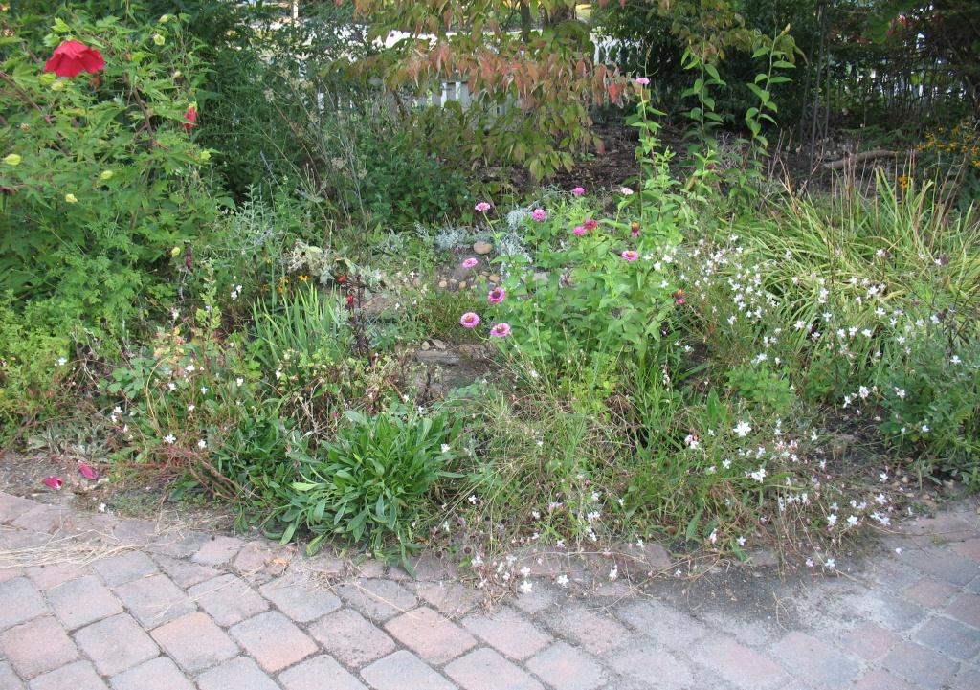
My Rain Garden

Slide 4
Indoor Water Use
American Water Works Research Foundation (1999) “Residential End Uses of Water”

Slide 5
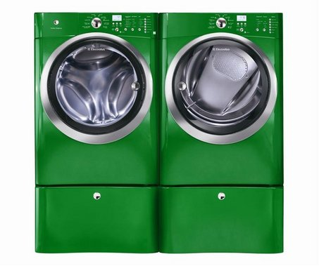
Water Conservation Opportunities
threadingourway.files.wordpress.com
Notes:
Showers, Faucets, Toilets
Dish washers, Clothes washers
Rainwater Catchment
Gray Water
Wastewater Reuse
Aquifer Recharge

Slide 6
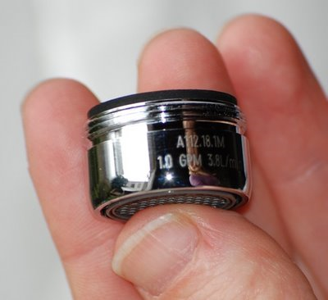
Low Flow Faucets & Heads
4.bp.blogspot.com
Aerator
Non-Aerating
Shut off Valve
ShowerStartTM
Turn on shower
At 95 °F flow reduces to trickle until you get in
JWE –most faucets also come with one or two levers, use ‘em!
evolveshowerheads.com
Notes:
Aerator
Adds air to water
Non-Aerating
Pulses Water
Shut off Valve

Slide 7
Case Study: Low Flow Faucet
www.greenandsave.com
Low flow faucets
~2.5 gpm (4 gpm for conventional faucets)
Case Study
(3) $80 low-flow faucets for office of 10 employees = $240
(2) Bathrooms & (1) Kitchen
Three uses per day per employee
Assume 1.5 gallons saved per washing (1 minute of water)
Assume $1.50 per 1,000 gallons
Assume hot water bill is $340 per year & low flow faucets reduce bill by 100 x (4-2.5)/4 = 40%
Savings:
Purchase | Annual SAVINGS | Payback Time (y) | 5 Year SAVINGS
$240 | $151 | 1.6 | $755
Notes:
Low flow faucets
~2.5 gpm (4 gpm for conventional faucets)
Case Study
(3) $80 low-flow faucets for office of 10 employees = $240
(2) Bathrooms & (1) Kitchen
Three uses per day per employee
3 use/d/emp x 10 emp x 5 d/w x 48 w/y = 7,200 uses per year
Assume 1.5 gallons saved per washing (1 minute of water)
1.5 gal saved/use x 7200 use/y = 10,800 gal saved per year
Assume $1.50 per 1,000 gallons
$1.50/1000 g x 10,800 g/y = ~$15 saved per year
Assume hot water bill is $340 per year & low flow faucets reduce bill by 100 x (4-2.5)/4 = 40%
0.4 x $ 340 = $136 saved per year
Savings: $136 plus the $15 = $151
Purchase Annual SAVINGS Payback Time (y) 5 Year SAVINGS
$240 $151 1.6 $755
Office Low-Flow Faucets - Low flow faucets have aerators and new technology in them to cut your water usage while maintaining the pressure. These faucets for restrooms and kitchen 'break rooms' use as much as 40% less water than conventional faucets, or about 2.5 gallons per minute compared to the 4 gallons per minute of conventional faucets.
When your employees wash their hands, you also save money by reducing the hot water heating costs since less water is running through the system. The ROI Calculation is based three $80 low-flow faucets with one for each of the men's and women's room and one in the kitchen or 'break room' for an office of ten employees. Three visits per day for ten employees adds up to 30 total visits per day, 150 per week, 600 per month and 7,200 per year. At a savings of 1.5 gallons per washing equals 10,800 gallons. At $1.50 per 1,000 gallons the water savings is just over $15 per year. This savings is only part of the story. Hot water heating, on average, is about 6% of US office energy bills, the average energy cost per employee is $586 per year bringing the hot water heating to $34 per employee per year.
Since very few offices have showers and a fraction of the hot water is used for washing dishes, the majority of hot water is used for washing hands. So, for the same office of ten employees the hot water bill averages $340 a year. With a 40% water reduction through the low flow faucets the savings add up to $136 plus the $15 in the gallons of water saved. Also look into ways to reduce the cost of heating water through Office Water Heater and Office On-Demand Water Heater.

Slide 8
Shorter Showers
www.apartmenttherapy.com
Shower timer
2-in-1 shampoo-conditioner combo
Short Music playlist
Luke warm or cold shower
Very small shower (makes showering less fun)
Navy shower!
3.bp.blogspot.com
Notes:
Shower timer
2-in-1 shampoo-conditioner combo
JWE – Or don’t use conditioner
JWE – Or don’t wash hair everyday
Short Music playlist
Luke warm or cold shower
JWE - Works esp. well in summer if home not over cooled (78 to 80 °F fine during day in summer)
Very small shower (makes showering less fun)
Navy shower!

Slide 9
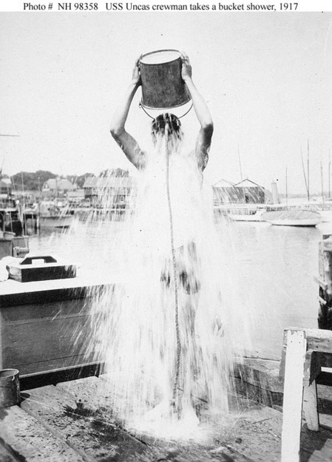
Navy Shower
en.wikipedia.org
www.norcalblogs.com
Notes:
Get wet
Turn off shower
Soap & Lather
Rinse
Can reduce water use up to 95 %

Slide 10
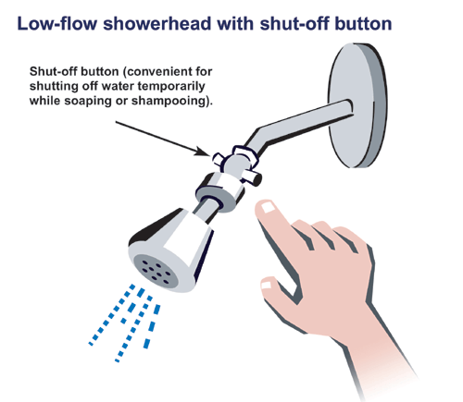
Shower Head
www.ehow.com
Regular
6 to 7 gpm & 80 psi
Low Flow
Restrict water flow while maintaining 80 psi
1.5 to 3 gpm
Shut off button or lever for navy shower
www.ec.gc.ca
Notes:
This weekend I installed low flow aerators on our kitchen (1.5gpm) and bathroom (1.0gpm) faucets - I didn't realize how easy it would be. Most aerators are stamped with their flow rate on the side but if they're really old (like mine) they might not, so you'll have to use your best judgment as to what you currently have. In fact, I noticed our bathroom faucet was missing the aerator all together.
Based on what I've read it seems that aerators below about 2.2gpm (gallons per minute) are considered low flow. I did listen to some advice I read that it helps to have a slightly higher capacity one in your kitchen to handle your higher water demands. I paid less than $6 each for them at OSH and they'll more than pay for themselves over their life through water and gas/electricity savings. Not to mention the fact that they definitely provide an adequate stream of water. The U.S. Department of Energy has an online calculator than can calculate your cost savings. After the fact, I read that our East Bay Municipal Utility District (EBMUD) actually provides these water conservation devices for free to their customers, oh well...

Slide 11
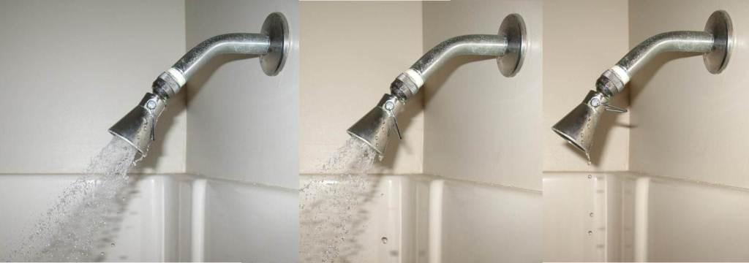
Shower Head with Lever

Slide 12
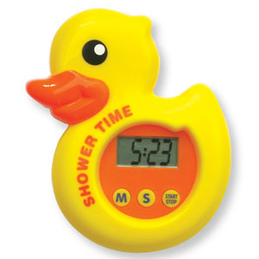
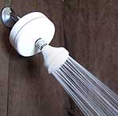
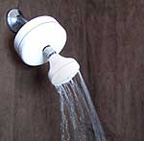
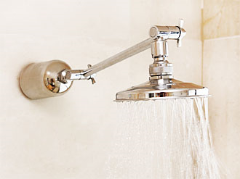
Shower Timer and/or Shut Off
www.apartmenttherapy.com
www.showermanager.com
Simple Timers
Trickle Shut offs
Complete Shut offs
Time or volume of water
Volume: no electricity
Some won’t come back on right away
www.aqualim.com.au
www.showertimer.com.au

Slide 13
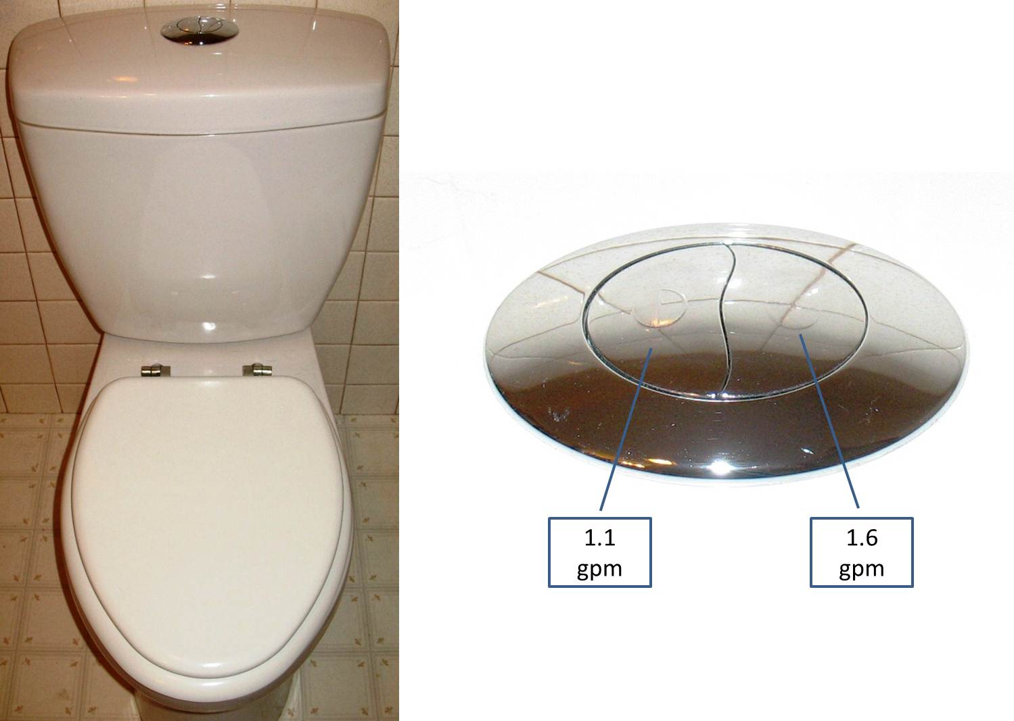
Toilet – Dual Flush

Slide 14
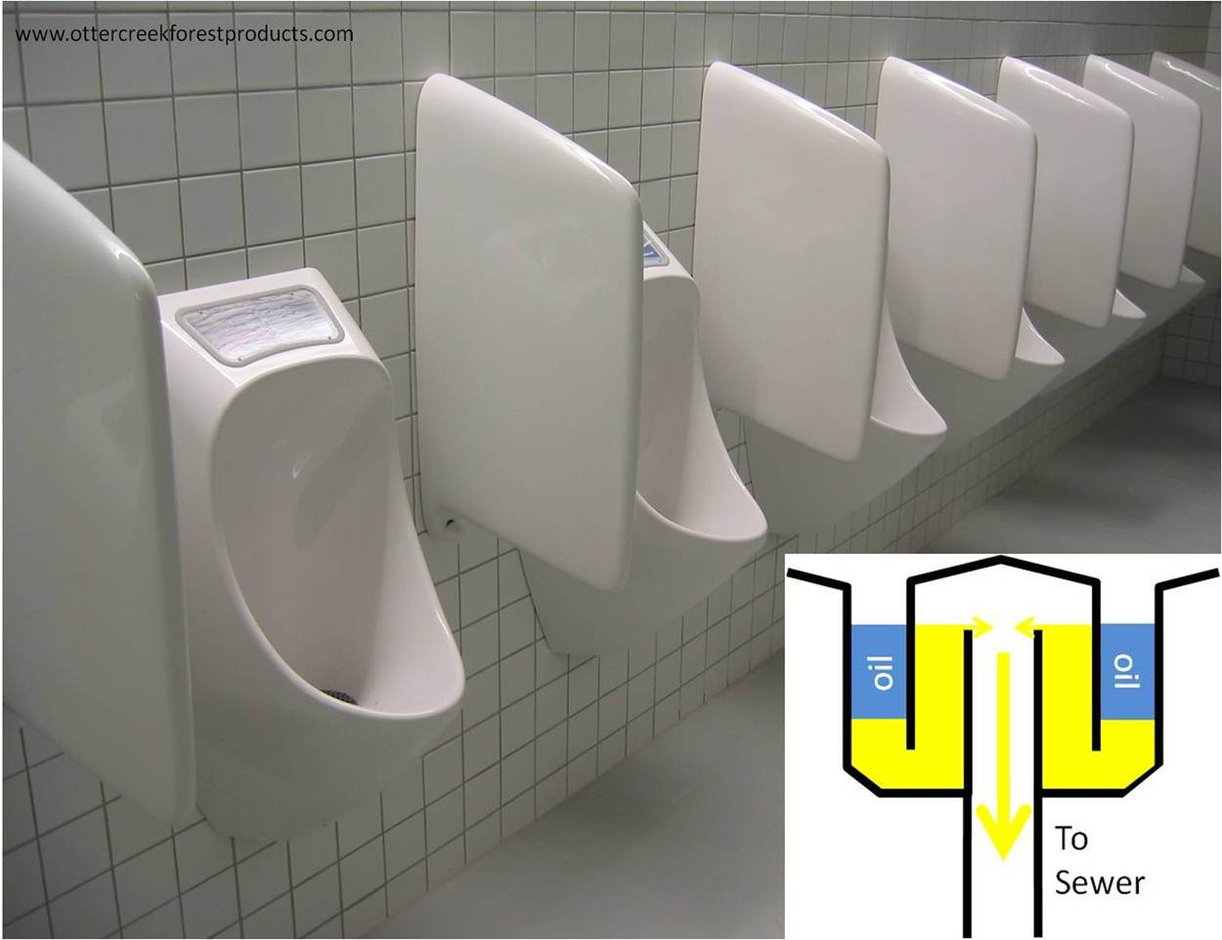
Waterless Urinal

Slide 15
Pee in Shower Campaign
www.marketplace.org
SOS Mata Atlantica (www.xixinobanho.org.br)
Brazilian Environmental Group
Goal: Protect Atlantic Forest
Pee In Shower
Save 4,380 liters of water annually / household
~one flush per day per person
TV Campaign (cartoon)
www.treehugger.com/clean-water/pee-in-the-shower-save-the-rainforest.html
www.youtube.com/watch?v=w1BNhCJU0ow&playnext=1&list=PL5295FADED452B52F&feature=results_video

Slide 16
Is Peeing in Public Green?
Pros
Save Water
Add nutrients to compost pile
Important source of phosphorous (& nitrogen)
Cons
Could be embarrassing
Could get you in trouble
Neat urine is strong for plants
Problems if too many people do it
Sami Grover
June 11, 2009
www.treehugger.com
Notes:
Sami Grover Business / Corporate Responsibility June 11, 2009
Peeing in Public Saves Water - But is it Gross? I seem to be in the habit of sharing my bathroom habits with the world - whether it's the Selective Flush or the Navy Shower. (Perhaps worryingly) people seem to enjoy reading about what I get up to in the privacy of my own home - or at least it usually stirs up a vigorous debate. So here's another one I've been musing about lately - peeing in public is an environmentally responsible thing to do. OK - so maybe I'm not really talking about peeing in public, but rather peeing outdoors. I mean, the folks that dirty our underpasses and stink out our phone booths are hardly paragons of treehugging virtue. But it seems to me that a discreet pee behind a bush is in many ways more sensible than spoiling perfectly good drinking water and then whisking it away for expensive, energy and water intensive 'treatment'.
So what can we do to remedy the situation? For those of us in the country, the at-home solution is easy enough. I regularly pee in my yard. Not only does this save water - but it has other uses too. A quick sprinkle of the compost heap helps start the decomposition process, and let's not forget that urine is an important source of phosphate. I also pee around the flower beds and chicken coop to keep deer and raccoons away. And if you want to do more, check out how to use urine as a fertilizer.
But what about townies? I actually know plenty of town folk who occasionally use a secluded corner of their yard as a temporary toilet. And I see nothing wrong with using our parks for relief when you are caught short - though you probably want to find some dense undergrowth to spare the social outrage (and any possible legal issues!). And in large crowds, it's probably best to stick to the toilets - eutrophication of waterways is a real problem at major events like music festivals etc.
Back in my home town of Bristol in the UK, and many other cities in Europe, where Friday night revelers are not always the best behaved bunch, they often set up temporary public urinals in the street, saving shopkeepers the unpleasant task of cleaning up after anti-social drunks. (I'll save readers the unpleasant sight - head over to LIFE if you really want to see what temporary urinals look like). But what if those urinals were not just glorified (and wall-less) chemical toilets, but rather a method for collecting a valuable resource that could be distributed to phosphate hungry farms in the region? After all, the New York Times has already identified "yellow as the new green" - arguing for urine separation in all of our toilets.
It looks like Umbra has been exploring some similar philosophical issues over at Grist - pondering whether it's polite to let it mellow when not at home, and putting her support behind peeing in public. It must be OK then...

Slide 17
How to use Urine as fertilizer
Keep it separate
Use it fresh
Starts to smell, looses nitrogen as urea becomes ammonia
Always dilute
at least 5:1, and up to 10:1 for tender plants & seedlings
Water at the roots.
Do not splash leaves: saves on evaporation & dry leaves more resistant to disease
Spread it around
can be salty: do not want salt to build up in soil
Feed hungry plants
Plants needing lots of nitrogen: leafy vegetables (cabbages & cauliflowers), corn, …
Other uses
Weed killer at 100%: may take a few applications
Winter spray for fruit trees: discourages fungal diseases
Speeds up composting; kick starts slumbering heap
www.howtodothings.com
Notes:
Keep it separate. The golden rule with urine use is to keep it separate from other bodily wastes. Urine is clean and needs to be kept that way. Pee in a bottle, or invest in a urine-separating toilet.
Use it fresh. We all know that stale urine smells. That's ammonia, and it's made from nitrogen. The smellier your collected urine, the less nutritious it will be for your plants, as well as being unpleasant to apply.
Always dilute. Urine is too strong to be used neat on plants. Dilute at least 5:1, and it can be diluted up to 10:1 for use on tender plants and seedlings.
Water at the roots. It's good practice when watering not too splash the leaves, but to water at the roots. This saves on evaporation, and dry leaves are much more resistant to disease.
Spread it around. Urine can be salty, and using too much of it in one place can harm plants. Use it throughout your garden so no one area suffers from an overdose, and don't use it every time you water a plant.
Feed hungry plants. The plants that will benefit most from urine fertilizer are the ones with the highest nitrogen requirements. Try it on leafy vegetables like cabbages and cauliflowers, corn, or anything that needs a quick pick-me-up.
Other uses. Neat urine is too strong to be used directly on plants, but it can be used as a weedkiller; a few applications, especially if used on hot days, should finish off your weeds. It can also be used neat as a winter spray for fruit trees, to discourage fungal diseases.
Activate! A final use for urine in the garden is as a compost activator. The nitrogen in urine will speed up the composting process and kick start a slumbering heap.

Slide 18
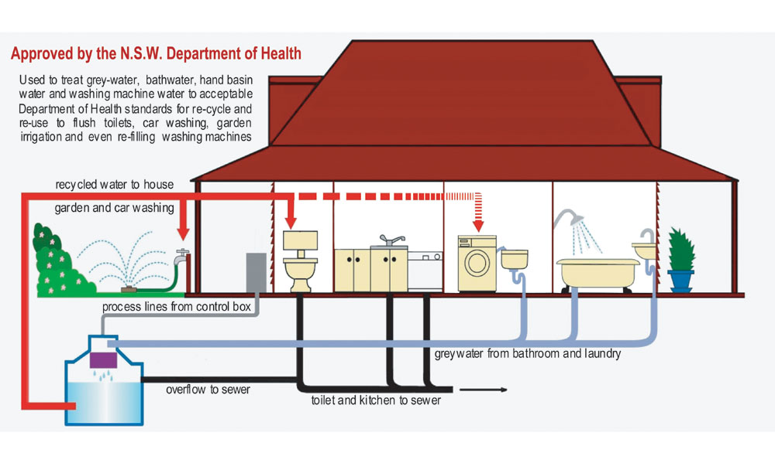
Grey Water
www.environmentwriter.com

Slide 19
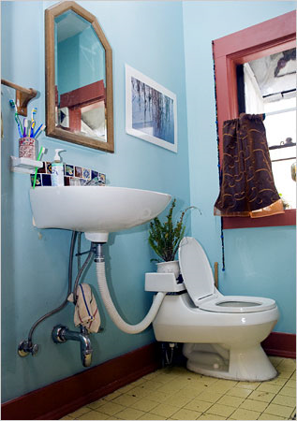
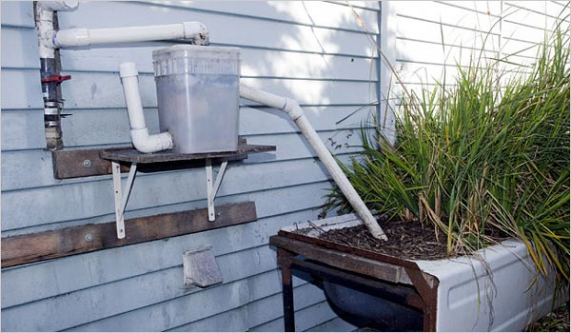
Grey Water
www.nytimes.com
Probably do not have permit for these!
Notes:
The Dirty Water Underground GREGORY DICUM May 31, 2007
www.nytimes.com

Slide 20
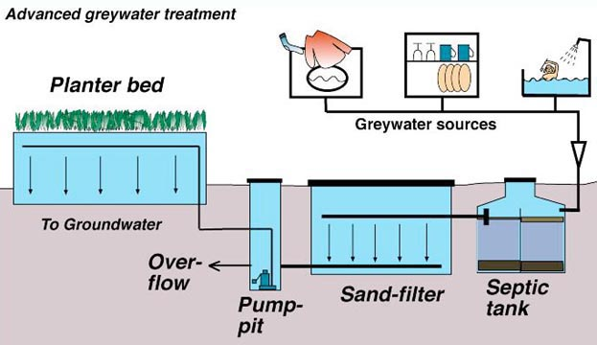
Grey Water
www.greywater.com

Slide 21
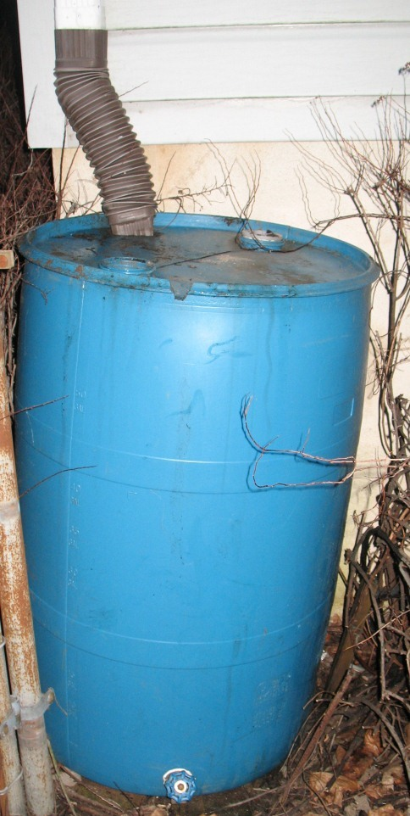
Rainwater Catchment
Small Scale
Small Scale
Downspout to Barrel
Irrigation
Larger Scale
Large Roof or Ground Catchment
Irrigation, Drinking, Toilet Flushing,…
Runoff Delivery
Gutters, pipes, slopes, inlets, trenches,…
Treatment
Storage
Above or Below Ground Tank
Reservoir

Slide 22
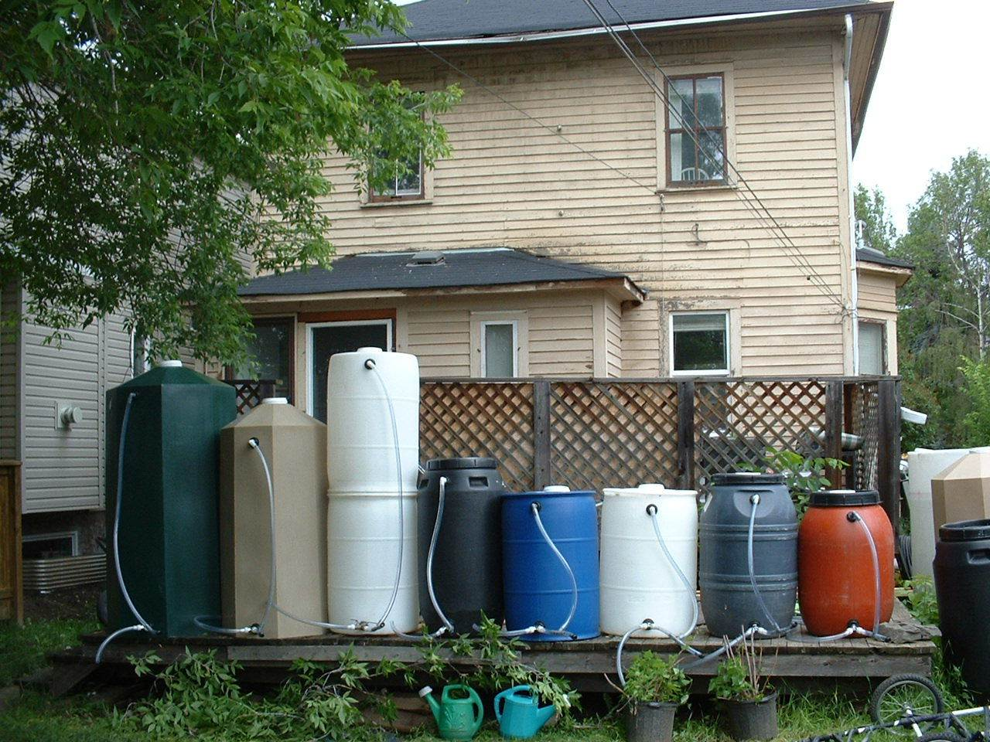
Rainwater Catchment - Barrel
www.egt.ca
1000 liters
200 liters
The Edmonton Rain Barrel Project
Notes:
The Edmonton Rain Barrel Project
2270 liters White NEW Product! Not shown in picture. New barrel - cylinder - 48”w x 90”h comes with installed retrofit kit $780.00
1250 liters White NEW Product! Not shown in picture. New barrel - cylinder - 35”w x 86”h comes with installed retrofit kit $500.00
1000 liters Green, Beige, Grey New barrel - octagonal cylinder - 36”w x 72”h comes with Overflow, Tap, Garden Hose Connection, New Barrels These are also available in gray granite and brown granite colors for an additional $50 $440.00
700 liters White NEW Product! Not shown in picture. New barrel - elliptical cylinder - 28"/30”w x 60”h comes with installed retrofit kit $440.00
500 liters Green, Beige, Grey New Barrels - Octagonal cylinder - 30w” x 60”h comes with Overflow, Tap, Garden Hose Connection These are also available in gray granite and brown granite colors for an additional $50
$275.00 400 White Reused Food Barrels comes with Overflow, Tap, Garden Hose Connection, $250.00
200 liters Black, Orange, Grey Reused Food Barrels - cylinder - 24”w x 36”h comes with Overflow, Lift off lid, Garden Hose Connection $135.00
200 liters Blue, White Reused Food Barrels - cylinder - 24”w x 36”h comes with Overflow, Lift off lid, Garden Hose Connection $120.00

Slide 23
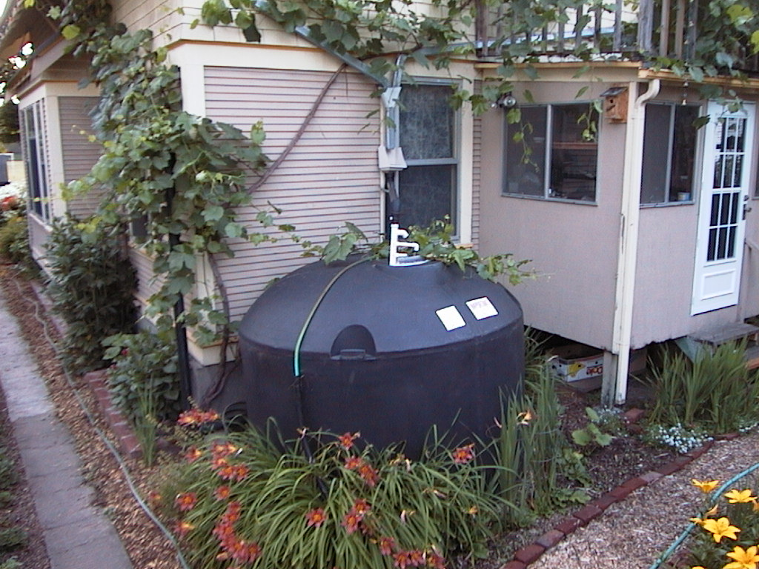
Roof Catchment w/ Above Ground Tank
www.harvestingwater.com

Slide 24
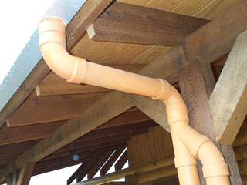
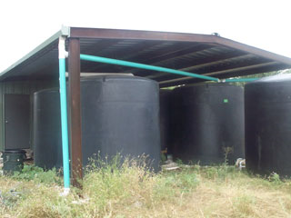
Case Study – West Texas
www.harvesth2o.com
West TX – 2003
Metal roofing and gutter system
5,900 ft² (548 m²) roof area
(5) 3,000 gallon tanks
(5) 1.6 gpm faucets
(2) low-flow shower heads
(2) 1.6 gallon/flush toilets
(1) high efficiency clothes washer
(1) ½ HP pump
(1) 40 gallon pressure tank
(3) Filters (0.80, 0.5 & 20 micron)
(1) Trojan Max Model C UV lamp
$6,500, not including gutters or labor
Notes:
Local Pioneer: Billy Kniffen - The 2 1/2 Minute Shower Man by Doug Pushard (www.harvesth2o.com/billy.shtml)
When Billy Kniffen and his wife, Mary, bought their five acre lot in West Texas in 2003 with the idea of building their log cabin dream home, there was one basic necessity missing: water - no city water access and ground water of questionable quality. Neither of the options for acquiring the precious liquid appealed to them: Pay for the city to trench 1000' through limestone (he wasn't sure the city would even approve this), or drill a well. Since his experience with drilling a well ten years ago left a bad taste in his mouth (he paid $8,000 to drill 280' to water that was sometimes sulfurous), he gazed up at the sky in wonder, and the obvious solution sprinkled down on him - capture what falls from the sky!
Billy Kniffen holds "a native grass kin to corn and very valuable for water infiltration, erosion control, ground nesting birds and as forage for livestock and wildlife."
With this plan in mind, the Kniffen's started work on their home. It was completed in May 2004, and the tanks were brimming just 2 months later! Much of the project was done by Billy himself, including building a barn, setting up the tanks and moving them into place (with help of a friend), installing the gutters, and connecting pipes and filters to complete the system. The house and barn roof total about 5,900 square feet (548 square meters) of catchment area and can capture roughly 2,900 gallons (10,991 liters) of water per inch of rain.
Billy knew from his time living near Austin, TX that conservation would be critical if they were going to live exclusively on rainwater. So he installed several water-saving devices in the home, including low-flow shower heads and faucets, low-flow toilet, on-demand hotwater recirculating water system, and landscaped with only native and low-water use plants. Being the avid environmentalist that he is, he takes it one step further - the 2 1/2 minute (or "Military") shower. "I first add shampoo to my hair, turn on the shower and get in and wash my hair. Then turn the water off and soap down, add conditioner to my hair, turn the water back on and rinse off - 2 1/2 minutes of total water time". Now that's conservation!
The results speak for themselves. Their overall average water consumption was 35 gallons (132 liters) per person per day in 2004. This amounts to 70 gallons (264 liters) a day, 2,100 gallons (7,959 liters) a month or 25,550 gallons (96,834 liters) a year. Average consumption in the United States is typically around 84 gallons (318 liters) a day per person. In an area that gets about 22 inches (55 centimeters) of rainfall a year, the roof of the barn and house are capable of catching over 63,000 gallons (238,770 liters) a year. Given Billy and his wife's sparingly light use of water, they will typically have a 7-month supply at any given time. To put it another way, only 8.81 inches (22.3 centimeters) of rain a year is required to meet their total water needs.
But what about the droughts? Would they be able to make it through the occasional drought? The record drought for the area was in 1951, when the area received only 7.64 inches (19.4 centimeters) and the second driest year was 1953 with only 9.22 inches (23.4 centimeters) of rain. So unless another record drought occurs, the current system should suffice.
Key System Components: - 5,900 square foot (548 square.meters) roof area - Metal roofing and gutter system - 5 - 3,000 gallon (11,370 liter) tanks - 5 - 1.6 gallon (6 liter) faucets - 2 - low-flow shower heads - 2 - 1.6 gallon (6 liter) toilet - 1 - high efficiency clothes washer - 1- ½ HP pump - 1 - 40 gallon (150 liter) pressure tank - 1 - .80 micron filter - 1 - 20 micron filter - 1 - .5 micron filter - 1 - Trojan Max Model C UV lamp
Total System Cost $6,500, not including gutters or labor
Billy's advice for those that want to follow in his footsteps: "Don't be afraid to try! Seek help and advice, but you can install it yourself. It definitely helps to see examples or get the advice of an experienced friend or consultant. Understanding plumbing basics is all that's required, along with reading and planning for tank size based on needs and roof size and determining the proper filtering methods."
After building his system from scratch, Billy advises that each part of the system takes time and effort to plan. "I built my own rain barn to use as a garage, shop and cover for the polypropylene tanks." He cautions that the 3, 000 gallon (11,370 liter) tanks are heavy, so be careful when moving them around. A master-gardener friend helped install UV lamp and filters. According to Billy, none of the system was too difficult. Filtering the water with roof washers or screens is a little difficult to get right. There are several methods out there and he is still not sure the easiest and best way.
Other green aspects of his log-country home include wood stove for heat, native landscape with no standard turf and a large wrap-around porch on 3 sides to avoid solar gain and to make comfortable shaded living space outside. They use grey-water from the washing machine to water the landscape and he even has added a slow moving stream and a pond. His current project is a cottage garden and raised beds in the back yard.
Billy is now an active promoter of rainwater harvesting in his area and his enthusiasm for the value and possibilities of this type of sustainability has proven to be contagious. Since he completed his system, at least three residents in the area have installed similar systems, and several other homeowners are considering one.
He has been sharing his knowledge and skills with youths in the community by working on a 10,000 gallon (37,900 liter) tank at the local county youth livestock barn and is planning to work with the school youth program in outdoor education. Other community efforts he has helped out on include installation of a 2,500 gallon (9,475 liter) tank on a county courthouse near El Paso and has plans for landscaping a new library and activity center in his town.
Through use of strategic planning for catching, storing, and directing even sparse rainfall, and using creativity in designing his landscape, Billy has demonstrated that landscape can be beautiful, functional, and sustainable. By educating youth and adults to be water conservationists, he's helping to ensure sufficient quantity water for generations to come.
More Info UV Lamp information Texas Rainwater Harvesting Vendors Texas Cooperative Extension - Menard County Extension Office Water Needs Calculator

Slide 25
Case Study – West Texas (Supply)
West TX Rainfall
Averages 22 inches / year (55 cm/y = 0.55 m/y)
Assuming system captures 80 % of water
S = 0.80 R A
S = Water Supply, m³/y
R = Rainfall, m/y
A = Collection Area, m²
S =
Notes:
West TX Rainfall
Averages 22 inches / year (55 cm/y = 0.55 m/y)
Assuming system captures 80 % of water
S = 0.80 R A
S = Water Supply, m³/y
R = Rainfall, m/y
A = Collection Area, m²
S = 0.80 ⋅ 0.55 m/y ⋅548 m² = 241 m³/y

Slide 26
Case Study – West Texas (Demand)
www.harvesth2o.com
Water Consumption
Typical American
85 gpd (318 l/d)
West TX Case Study
Two People - West TX Case Study
D =
Supply versus Demand
How little rainfall can they get by with?
Notes:
Water Consumption
Typical American
85 gpd (318 l/d)
West TX Case Study
35 gpd (132 l/d)
Two People - West TX Case Study
D = 2 ⋅ 132 l/d x 365 d/y = 96,360 l/y = 96.4 m³/y
Supply versus Demand
241 m³/y > 96.4 m³/y ← Typical Year is Fine!
How little rainfall can they get by with?
(96.4 / 241) ⋅ 22 inches = 8.8 inches (22.3 cm)
Only one recorded year was lower (1951)

Slide 27
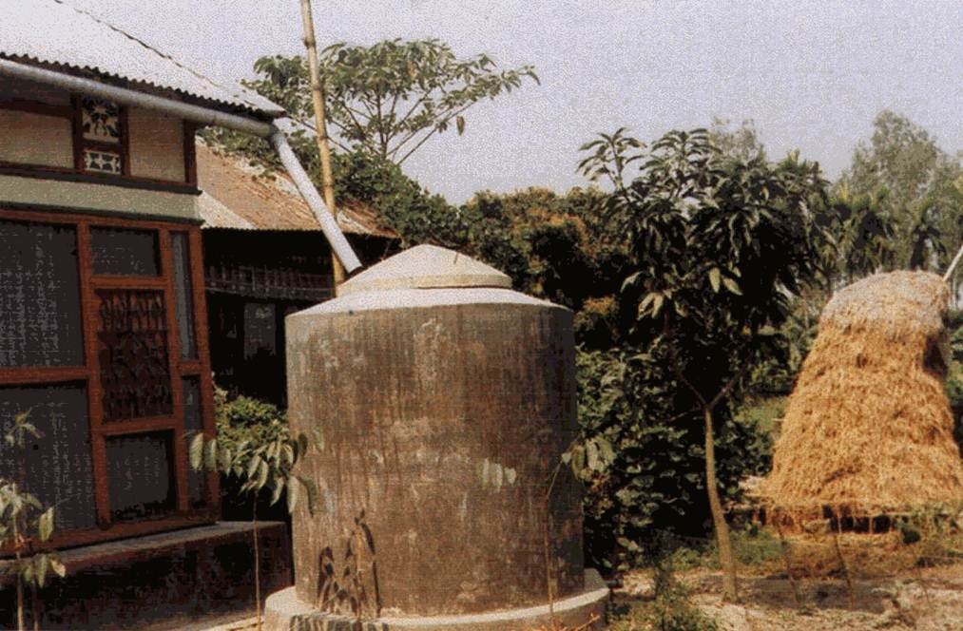
Rainwater Catchment Design
Demand
Rainfall
Supply
Treatment
Storage
Bangladesh
bicn.com

Slide 28
Demand, D
People
Other Demands
Glassboro Example: 3 people using 6 ft³/person/day, w/ 1 person off-site half the year
D =
Gould & Nissen-Petersen 1999 “Rainwater Catchment Systems for Domestic Supply” Intermediate Technology Publications
Notes:
Box:
~0.7 ft³/p/d in developing world
+20 ft³/p/d in USA!
TX Case Study: 4.7 ft³/p/d
People
How Much per Person? Conservation?
How Many?
How Often Are they Onsite?
Other Demands
Animals
Crops
Glassboro Example: 3 people using 6 ft³/person/day, w/ 1 person off-site half the year
D = 2.5 ⋅ 6 ft³/p/d ⋅ 365 d/y = 5,475 ft³/y

Slide 29
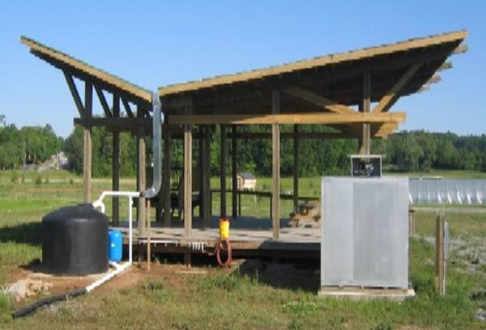
Rainfall
www.clemson.edu
Year | Rainfall (inches)
1963
1964
1965 | 29.25
1966 | 36.64
1967 | 52.54
1968 | 31.06
1969 | 44.98
1970 | 40.72
1971 | 54.24
1972 | 55.68
1973 | 46.8
1974 | 41.51
1975 | 63.41
1976 | 36.91
1977 | 43.88
1978 | 39.54
1979 | 54.16
1980 | 33.06
1981 | 43.24
1982
1983 | 55.45
1984 | 47.35
1985
1986
1987 | 41.20
1988 | 37.92
1989 | 56.18
1990 | 49.41
1991 | 42.27
1992 | 36.57
1993
1994
1995 | 42.21
1996
1997
Rainfall data
Readily available on-line, e.g., NOAA
Glassboro Example
Glassboro, NJ, Monthly, 1963 to 1997
(26 years w/ complete data)
NOAA - National Oceanic & Atmospheric Admin
Mean Annual Rainfall = 44.5 inches
Notes:
gcmd.nasa.gov/records/GCMD_COOP-PRECIP_NCDC.html

Slide 30
Supply Systems & C_{r}
Roof
Ground
C_{r} = Runoff Coefficient
Fraction of rainfall that will make it to the storage unit
Others put sheet metal and asphalt shingle >0.90
Material | Runoff Coefficient, C_{r}
Roof System
Sheet Metal | 0.80-0.85
Cement Tile | 0.62-0.69
Clay Tile (Machine made) | 0.30-0.39
Clay Tile (Hand-Made | 0.24-0.31
Ground System
Concrete-Lined | 0.73-0.76
Cement Soil Mix | 0.33-0.42
Buried Plastic Sheet | 0.28-0.36
Gould & Nissen-Petersen 1999 “Rainwater Catchment Systems for Domestic Supply” Intermediate Technology Publications
Notes:
www.netplaces.com/living-off-the-grid/water-water-everywhere/harvesting-water.htm
Roof: metal, gravel, asphalt, shingle, fiberglass, mineral paper—high coefficient 0.95, low coefficient 0.90
Paving: concrete, asphalt—high coefficient 1.00, low coefficient 0.90
Gravel: high coefficient 0.70, low coefficient 0.25
Soil: flat, bare—high coefficient 0.75, low coefficient 0.20
Soil: flat, with vegetation—high coefficient 0.60, low coefficient 0.10
Lawns: flat, sandy soil—high coefficient 0.10, low coefficient 0.05
Lawns: flat, heavy soil—high coefficient 0.17, low coefficient 0.13

Slide 31
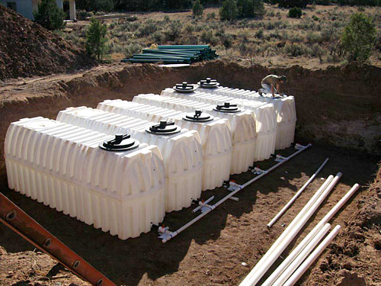
Supply
S = R A C_{r}
S = Annual Supply, Volume
R = Annual Rainfall, Height
Mean annual rainfall, OR
Minimum annual rainfall, OR
rainfall exceeded some percent of time
A = Catchment Area, Area
Glassboro Example
Assume 2,000 ft² (A) Sheet metal roof, C_{r} = 0.80
Mean Rainfall, R = 44.5 inches / year
S =
Minimum Acceptable Rainfall?
www.theraincatcherinc.com
Gould & Nissen-Petersen 1999 “Rainwater Catchment Systems for Domestic Supply” Intermediate Technology Publications
Notes:
Glassboro Example
Assume 2,000 ft² (A) Sheet metal roof, C_{r} = 0.80
Mean Rainfall, R = 44.5 inches / year
S = 44.5 in/y ⋅ 2000 ft² ⋅ 0.80 (1ft/12in) = 5,900 ft³/y
5,900 ft³/y > 5,475 ft³/y ←OK for typical year
Minimum Acceptable Rainfall?
Min R = D / (A C_{r}) = [5475/(2000 ⋅0.80)]12 = 41.1 in/y

Slide 32
Glassboro Annual Precipitation

Slide 33
Design & Probability
Rank | R (inches) | PP (%)
1 | 29.25 | 3.70
2 | 31.06 | 7.41
3 | 33.06 | 11.11
4 | 36.57 | 14.81
5 | 36.64 | 18.52
6 | 36.91 | 22.22
7 | 37.92 | 25.93
8 | 39.54 | 29.63
9 | 40.72 | 33.33
10 | 41.2 | 37.04
11 | 41.51 | 40.74
12 | 42.21 | 44.44
13 | 42.27 | 48.15
14 | 43.24 | 51.85
15 | 43.88 | 55.56
16 | 44.98 | 59.26
17 | 46.8 | 62.96
18 | 47.35 | 66.67
19 | 49.41 | 70.37
20 | 52.54 | 74.07
21 | 54.16 | 77.78
22 | 54.24 | 81.48
23 | 55.45 | 85.19
24 | 55.68 | 88.89
25 | 56.18 | 92.59
26 (N) | 63.41 | 96.30
Do we want enough water every year?
Probability Estimation w/ Plotting Position, PP (%)
Rank Rainfall, R: smallest to largest
PP = 100⋅Rank/(N+1)
N = number of data points
Example →
For Rank = 1, R =
Plotting position =
Glassboro Example
Notes:
Use N+1 to account for short data record (Could have smaller or larger rainfalls then in the short record).
Do we want enough water every year?
Design for a rainfall that is likely to be exceeded most, if not all, years
Probability Estimation w/ Plotting Position, PP (%)
Need decades of data
Rank Rainfall, R: smallest to largest
PP = 100⋅Rank/(N+1)
N = number of data points
Example →
For Rank = 1, R = 29.25 in/y
Plotting position = 100 ⋅ 1/(26+1) = 3.7 %
There is a 3.7 % chance of annual rainfall less than 29.25 inches based on the 26 year record

Slide 34
Plot Rainfall Cumulative Probability
Notes:
36 % of years have less than 41.1 in
10 % of years have less than 32.5 in

Slide 35
Glassboro Example: Options?
Live with it
Increase Catchment (Roof Area)
Want enough water in 9 of 10 years?
R ≥ 32.5 inches:
Min A = D / (R C_{r}) =
Notes:
Live with it
Supplement from Public System as needed
Not enough water ~1 of 3 years
Increase Catchment (Roof Area)
Want enough water in 9 of 10 years?
R ≥ 32.5 inches (PP Graph) in 9 of 10 years
Min A = D / (R C_{r}) = [5475/(32.5⋅0.80)]12 = 2530 ft³
Decrease Demand

Slide 36
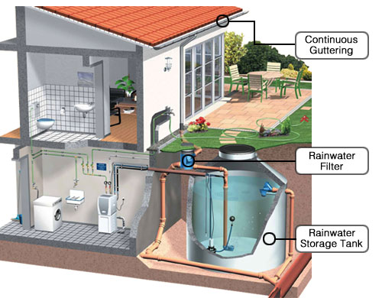
Treatment
www.nirmaljal.net
Filtration
Sieve type or Sand
Disinfection
Chlorine, Chloramines, UV, Sunlight
Other
Carbon
Reverse Osmosis
Boiling

Slide 37
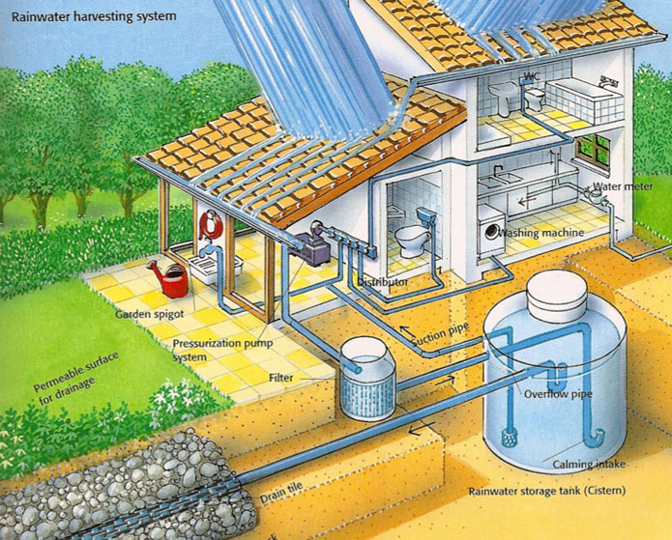
Storage, V_{s}
www.selba.org
Short Term
Long Term
Notes:
Short Term
Between individual rainfall events
Long Term
Over Dry Season

Slide 38
Storage, Short Term
How many days supply do you want?
V_{s} = T D
T = Time
D = Demand
Glassboro Example
V_{s} =
Notes:
Glassboro Example
Design Storage for 2 weeks
V_{s} = 14 d 5475 ft³/y (y/365 d) = 210 ft³ (~1500 gal)
1500 gallon plastic tank costs ~$600

Slide 39
Storage, Long Term
Use Mass Curve to determine storage needed to get through dry season
Plot cumulative Demand & Supply to find maximum deficient, Max_{d}
V_{s} = Max_{d} = Max(D_{c} – S_{c})
D_{c} = Cumulative Demand
S_{c} = Cumulative Supply
Glassboro Example: D_{c}
Notes:
Glassboro Example: D_{c}
5,475 ft³/y / 12 = 456 ft³/m

Slide 40
Glassboro Example: S_{c}
Month | Mean Rain (in) | Cumulative Supply (ft³)
January | 3.47 | 3.47⋅2000⋅0.80/12 = 462
February | 2.81 | 462 + 2.81⋅2000⋅0.80/12 = 836
March | 3.96 | 836 + 3.96⋅2000⋅0.80/12 = 1365
April | 3.81 | 1365 + 3.81⋅2000⋅0.80/12 = 1873
May | 3.97 | 1873 + 3.97⋅2000⋅0.80/12 = 2402
June | 3.56 | 2402 + 3.56⋅2000⋅0.80/12 = 2877
July | 4.36 | 2877 + 4.36⋅2000⋅0.80/12 = 3458
August | 4.23 | 3458 + 4.23⋅2000⋅0.80/12 = 4022
September | 3.64 | 4022 + 3.64⋅2000⋅0.80/12 = 4507
October | 3.33 | 4507 + 3.33⋅2000⋅0.80/12 = 4951
November | 3.55 | 4951 + 3.55⋅2000⋅0.80/12 = 5425
December | 3.84 | 5425 + 3.84⋅2000⋅0.80/12 = 5938
Annual | 44.47 | 5938
Notes:
5,475 ft³/y / 12 = 456 ft³/month

Slide 41
Glassboro Example: Mass Curve
Supply
Notes:
No Dry Season in Eastern US!
Max_{D} = 75 ft³ (February)
Short term storage controls
Start demand from a point where supply dips

Slide 42
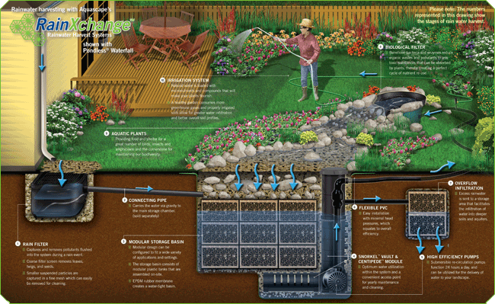
Max_{D} Calculation - Excel
www.rainxchange.com
 | JAN | FEB | MAR | APR | MAY | JUN | JUL | AUG | SEP | OCT | NOV | DEC
S_{c} | 462 | 836 | 1365 | 1873 | 2402 | 2877 | 3458 | 4022 | 4507 | 4951 | 5425 | 5938
D_{c} | 456 | 912 | 1368 | 1824 | 2280 | 2736 | 3192 | 3648 | 4104 | 4560 | 5016 | 5472
(D_{c}-S_{c}) | -6.18 | 75.8 | 3.4 | -48.7 | -122.4 | -140.6 | -265.8 | -373.8 | -403.5 | -391.4 | -409.2 | -465.6
Notes:
Max_{dif} in FEB

Slide 43
Hypothetical Dry Season
Notes:
Month 5
Max_{D} = 530 ft³ (May)
Long term storage controls

Slide 44
Mass Curve Caveat
Plot cumulative demand from start of dry season
Storage =
Notes:
Storage = 3223-1551 + 4654-3811 = 2515 ft³

Slide 45
Summary

